Slide 1
Data Program Data product definition
20th, January 2025
DELI-GEN-FSG-DAPG-001-A0

Slide 2
Versioning follow-up
Index | Date | Main changes | Proposed by | Reviewed by | Validated by
A0 | 20/01/2025 | First release | P. BRET | C. VANEENOGE | D. DESMONS C. PERSOZ
A1 | 03/02/2025 | Removed appendix | P. BRET | C. VANEENOGE
DATA PRODUCERS
Public:
Yellow = updates since release A0 (20/01/2025)

Slide 3
Agenda
What is a data product?
How to make a data product?
1
2
Notes:
Il vaudrait mieux faire ce doc en anglais

Slide 4
What is a data product?
01

Slide 5
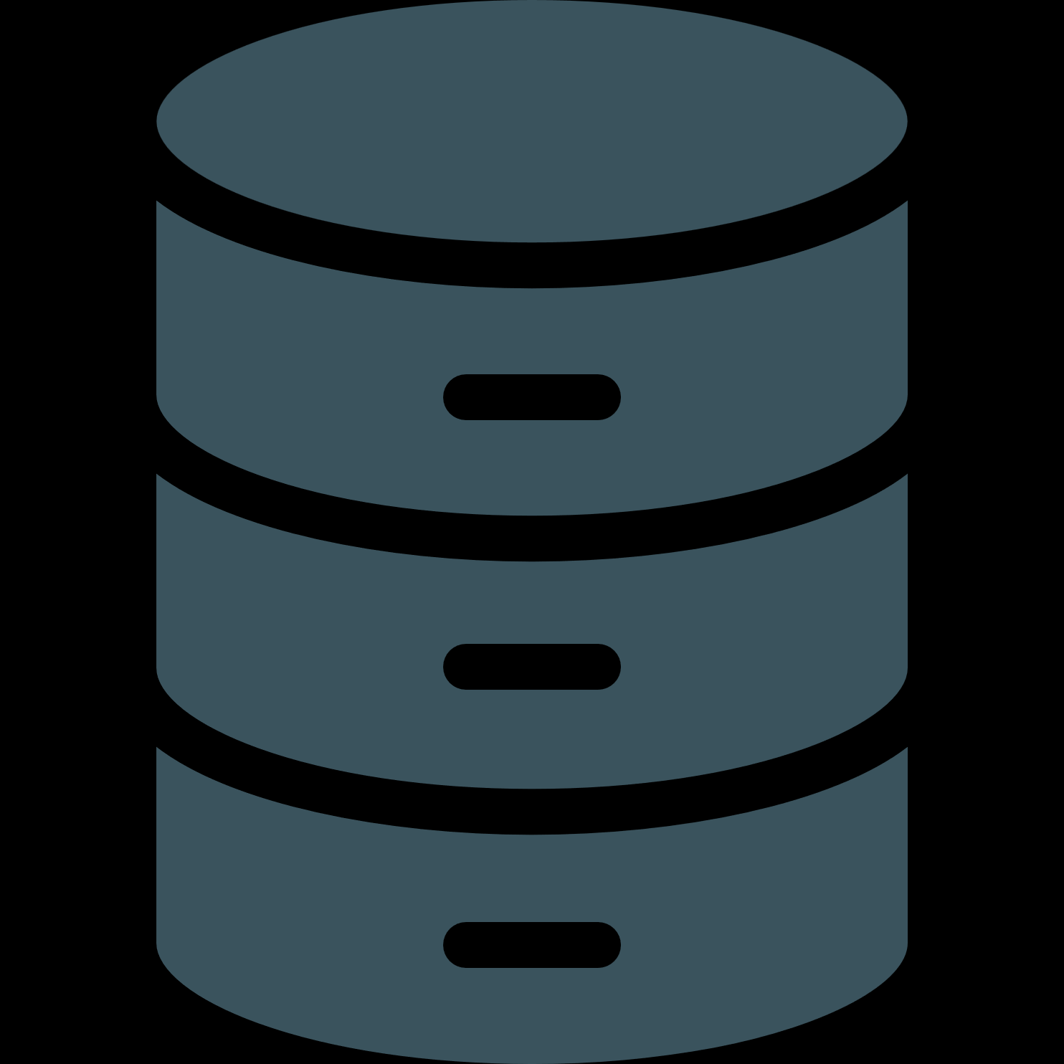
Shifting from use case specific mindset to data product mindset
DATA BY USE CASE
DATA AS A PRODUCT
UC
UC
UC
UC
UC
UC
UC
UC
UC
Domain 1
Domain 2
Dataset
Dataset
Dataset
Data Product - A
Data Product - B
Data Platform
Prepare Data
Prepare Data
Prepare Data
Data Platform
Build Product
Build Product
Collect Data
Collect Data
Collect Data
Collect Data
Collect Data

Slide 6
What is a data product?
Defined: all the data on a defined scope
(Ownership, Business Object, Application / perimeter)
A data product is a dataset
meeting the following requirements:
Self-Describing: easy understanding
(Column naming and labels)
Discoverable: find info to use the data
(Data product publication and fields description)
Data
Product
Accessible: easy access for various needs
(SQL Endpoint, Consistency, Interoperability)
Secure: protect data
(authentication, Authorization, GDPR)

Slide 7


There are different types of data products
Source Data Product
Composite Data Product
Transactional data or Master data
These data products are relatively raw and not specialized. Minimal data modeling and calculated indicators.
They are the generic bricks used by data producers to create the composite data products
They are mainly used by data specialists (Data Analysts & Data Engineer).
Facts and Dimensions – “cubes”…
These data products are specialized. They are designed to serve a specific purpose and include modeling and calculated indicators.
These data products mainly serve a single purpose (use case). They can be reused in variations of the same use case.
They are used by everyone, including business users (citizen data analysts).
In the following slides, you will find an examples of a source and a composite data product

Slide 8
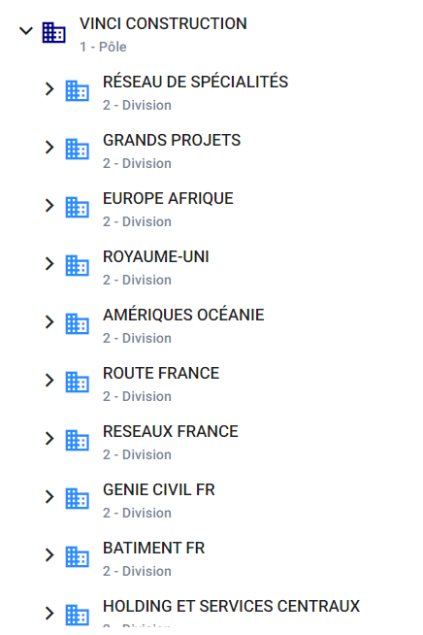
Example of a source data product
From deliverables
COR – Managerial organization
Need: Share a common organizational structure for BI and AI projects
Solution : Provide a common organizational structure in an appropriate format
Perimeter : Vinci Construction
Target Users : Every data Consumers
Data Product Checklist
Define : Managerial organization is a single business object. Legal organization is another data source data product.
Self-Describing : Fields are correctly named to immediately understand their meaning
Discoverable : The data product is not yet discoverable in the Data Catalog
Accessible : The data product is available in Power BI and SQL formats.
Secure : The Data owner has decided that the product will be freely available to all of VINCI-Construction.
COR – Managerial organisation
DELI-GEN-PRE-DAPG-003-A1 Data Program - End user introduction

Slide 9
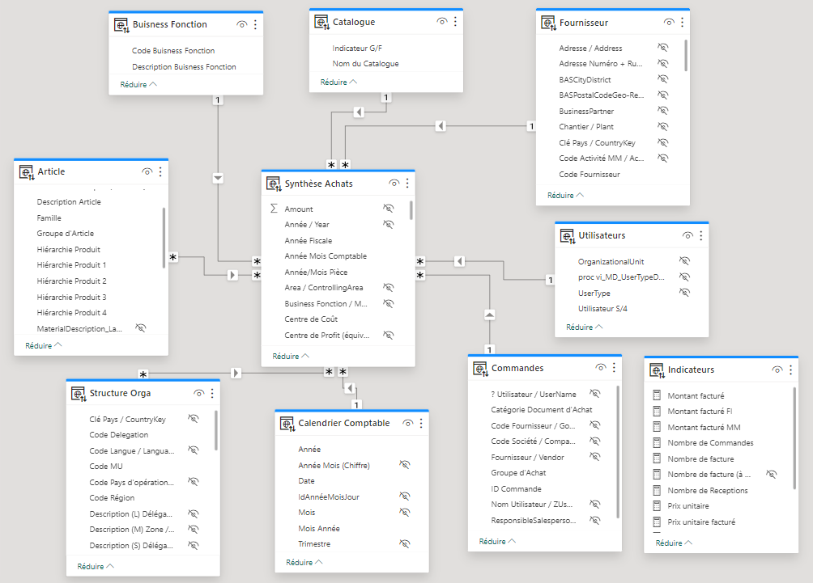
Example of a composite data product
Order Synthesis
Need: Cross-reference delivery and invoice data (from the Connect PR372 report) with local data.
Solution : Add a new data consumption format in the form of a Power BI model (+ SQL)
Perimeter : Connect France
Target users : Purchasing referents
Order Synthesis (Invoices and Deliveries)
Data Product Checklist
Define : The dataset contains the data required for analysis (no more, no less). With one single fact table and multiple dimensions.
Self-Describing : Fields are correctly named to immediately understand their meaning
Discoverable : The data product is exposed in the Data Catalog (which groups all data products).
Accessible : The data product was already available in AFO. It is now also available in Power BI and SQL
Secure: Only authorized users can access data.
AFO : Analysis for Office, equivalent pivot tables in excel
SQL : database format

Slide 10
How to make a data product?
02

Slide 11
How do I define a data product?
Who’s responsible?
DATA
OWNER
WHAT
A data product is defined if it contains all the data on a defined scope
(business object, fact and dimensions, perimeter, application…)
WHY
To ensure complete data on a topic for easy reuse
HOW - GOVERNANCE RULES
ID | Type | Applies to | Criteria | Example
1 | Mandatory | Source & Composite | Ownership: The data product must have a data owner (must be business), a data steward and a data factory (can be several depending on technologies) | « COR – Managerial organisation » data owner: Jean-Luc Mitry, data Steward: Grégory Julier & data factory : MS Data factory
2 | Mandatory | Source & Composite | Application/Perimeter: The Data Product must have a clearly defined application or perimeter | The scope of “Order Synthesis” is Connect deployed perimeters
3 | Mandatory | Source | Business Object: Source data product must fully describe one business object | The COR use case has been divided into multiple data products. One with the managerial structure, another with the legal structure.
4 | Best practice | Composite | Star schema: The data product should only contain one single fact table related to several dimension table | The “order synthesis” data product only contains one fact table.

Slide 12
How do I make my data product self-describing ?
Who’s responsible?
DATA
OWNER
WHAT
A data product is self-describing if the consumers can have a basic understanding of the content without additional resource.
WHY
Simplify consumption across domains & teams (break silos). Enable self-service
HOW - GOVERNANCE RULES
ID | Type | Applies to | Criteria | Example
5 | Mandatory | Source & composite | Columns Naming: Every Table and Column should have a complete and meaningful name: Abbreviation must be avoided The names should be understandable by anyone with basic understanding in this field (avoid « local » or « technical » names). When a defined Business term exists in the glossary, use it! | Avoid SAP abbreviation like « MATNR », « EQNR » etc. Refer to the Connect glossary when naming your data product so you’re using Vinci-construction’s common language.
6 | Mandatory | Source & composite | Labels: For every column containing a codification, a matching column containing labels should exist | In « Order synthesis » data product, on the material dimension, material classification both has a codification « Product hierarchy level X » and a corresponding label « Family level X »

Slide 13
How do I make my data product discoverable?
Who’s responsible?
DATA
STEWARD
WHAT
A data product is discoverable if the consumers can easily find it with the information to use it
WHY
Enable self-service scenarios and reuse of existing trustworthy assets
HOW - GOVERNANCE RULES
ID | Type | Applies to | Criteria | Example
7 | Mandatory | Source & composite | Publication: The data product must be published with its ID card completed (stakeholders, data classification and at least a description in English with keywords to facilitate data product search) | The « Order synthesis » data product is published and has a description in English and French, keyworks such as « purchases » and « PR372 » , a owner, a steward etc.
8 | Mandatory | Source & composite | Fields definition: All business fields with specific rules and calculated fields must have a definition. | The « Order synthesis » data product has its main dimension and fact fields described in the marketplace.

Slide 14
How do I make my data product Accessible ?
Who’s responsible?
DATA
ENGINEER
WHAT
A data product is accessible if the consumers can easily connect to it and work with the data.
WHY
Mix or reconciliate different data products (compatibility between technologies). Use AI
HOW - GOVERNANCE RULES
ID | Type | Applies to | Criteria | Example
9 | Mandatory | Source & composite | SQL Endpoint: A data product might have different consumption methods but must at least include a scalable SQL endpoint accessible from VC network (optimized performance for numerous consumers in self-service) | The « Order synthesis » data product is available as: A synapse scalable serverless SQL endpoint - a SAC (sap analytics cloud) report (PR372.01) - an AFO (analysis for office) report (PR372) - a Power BI semantic model
10 | Mandatory | Source & composite | Consistency: If a data product is available through multiple means, the data content must be the same across all technologies. Only the last layer (=semantic layer) may differ to include dynamic measures | In « Order synthesis » the business rules are preserved across all consumption methods. The same data is displayed everywhere (just in different formats).
11 | Mandatory | Source & composite | Interoperability: A data product must be based on existing master data and contain keys to enable reconciliation | The "purchasing synthesis" data product contains a "Material" dimension. This dimension has the SAP Material number in its fields. Thus, we can reuse this table in many SAP based data products.

Slide 15
How do I make my data product secure ?
Who’s responsible?
DATA
STEWARD
DATA
ENGINEER
WHAT
A data product is secure if only authorized users can access data, on the authorized perimeter.
WHY
Protect VINCI Construction valuable data, give only necessary access, Avoid data leakage
HOW - GOVERNANCE RULES
ID | Type | Applies to | Criteria | Example
12 | Mandatory | Source & composite | Authentication: The data product must ensure that only authenticated users can access its content. | The « Order synthesis » data product requires users to authenticate via SSO before accessing any tables or records.
13 | Mandatory | Source & composite | Authorization: The data product must enforce role-based access control to restrict actions based on user permissions. Authorizations are defined by the Data Owner | The « Order synthesis » data product allows only users with the “Build" role to build reports, while other roles have read-only access. Access requests are validated by the Data Owner and then applied by the Data Steward
14 | Mandatory | Source & composite | GDPR: Personal data inside a data product must be listed, justified, communicated to users and deleted at the end of the defined retention period | .The “Telematic Data for Worksites Equipment” data product contains personal information and GDPR impacts have been assessed and dealt with. : GPS data retention period reduced to 1 year for all cars and utility vehicles Removal of the 'Driver' field from the database.
15 | Best practice | Source & composite | Network: A data product must only be accessible via VC’s network (except for public data). | Use private endpoints in Azure
Notes:
Authentication
Type: Mandatory
Criteria: The data product must ensure that only authenticated users can access its content.
Example: The « DATA_PRODUCT_NAME » data product requires users to authenticate via SSO before accessing any tables or records.
Authorization
Type: Mandatory
Criteria: The data product must enforce role-based access control to restrict actions based on user permissions.
Example: The « HR » data product allows only users with the "Manager" role to edit or delete data, while other roles have read-only access.
Sovereignty
Type: Mandatory
Criteria: he data product must comply with the organization's sovereignty rules and adhere to all applicable local laws and regulations regarding data storage and handling.
Example: The « FINANCIAL » data product stores all financial data within the EU region to comply with European data sovereignty regulations.
Ownership
Type: Mandatory
Criteria: The data product must have clearly defined ownership and responsibility for managing access and updates.
Example: The « SALES » data product is owned by the Sales department, which manages permissions and ensures data accuracy.
VINCI Classification
Type: Mandatory
Criteria: The data product must be classified according to VINCI's data classification policy, ensuring proper handling based on sensitivity.
Example: The « HR » data product is classified as "RESTRICTED" under the VINCI policy, and access is restricted to specific personnel.
Impact RGPD (GDPR Impact)
Type: Mandatory
Criteria: The data product must be clearly identified, and its GDPR implications must be thoroughly assessed.
Example: The « CUSTOMER » data product ensures that all personal data is flagged, and a full assessment of GDPR compliance, including consent management and data retention policies, is conducted before use.

Slide 16
Data product checklist (mandatory criteria)
Requirement | ID | Criteria | Status | Comments
Defined | 1 | Ownership: The data product must have a data owner (must be business), a data steward and a data factory (can be several depending on technologies) | OK or KO | Data Owner: ………….. Data Steward: ……………… Data factory: …………………….
 | 2 | Application/Perimeter: The Data Product must have a clearly defined application or perimeter |  | Application or perimeter: …………….
 | 3 | Business Object: Source data product must fully describe one business object |  | Business object: ………………
Self-Describing | 5 | Columns Naming: Every Table and Column should have a complete and meaningful name: Abbreviation must be avoided The names should be understandable by anyone with basic understanding in this field (avoid « local » or « technical » names). When a defined Business term exists in the glossary, use it! |  | Number of tables : ….. Number of columns : …..
 | 6 | Labels: For every column containing a codification, a matching column containing labels should exist |  | Number of label columns: ……
Discoverable | 7 | Publication: The data product be published with its ID card completed (stakeholders, data classification and at least a description in English with keywords to facilitate data product search) |  | Data classification: ……….. Keywords: ………….
 | 8 | Fields definition: All business fields with specific rules and calculated fields must have a definition. |  | Number of field with a definition: ………….
Accessible | 9 | SQL Endpoint: A data product might have different consumption methods but must at least include a scalable SQL endpoint accessible from VC network (optimized performance for numerous consumers in self-service)
 | 10 | Consistency: If a data product is available through multiple means, the data content must be the same across all technologies. Only the last layer (=semantic layer) may differ to include dynamic measures
 | 11 | Interoperability: A data product must be based on existing master data and contain keys to enable reconciliation |  | Master data used: ………………..
Secure | 12 | Authentication: The data product must ensure that only authenticated users can access its content.
 | 13 | Authorization: The data product must enforce role-based access control to restrict actions based on user permissions. Authorizations are defined by the Data Owner
 | 14 | GDPR: Personal data inside a data product must be listed, justified, communicated to users and deleted at the end of the defined retention period |  | Personal data : …………………….

Slide 17




